Slide 1





Measure of Impurity: GINI
Gini Index for a given node t :
    (NOTE: p( j | t) is the relative frequency of class j at node t).
  Maximum (1 - 1/n_{c}) when records are equally distributed among all classes, implying least interesting information
  Minimum (0.0) when all records belong to one class, implying most interesting information

Slide 2



Examples for computing GINI
P(C1) = 0/6 = 0 P(C2) = 6/6 = 1
Gini = 1 – P(C1)² – P(C2)² = 1 – 0 – 1 = 0
P(C1) = 1/6 P(C2) = 5/6
Gini = 1 – (1/6)² – (5/6)² = 0.278
P(C1) = 2/6 P(C2) = 4/6
Gini = 1 – (2/6)² – (4/6)² = 0.444

Slide 3

Splitting Based on GINI
Used in CART, SLIQ, SPRINT.
When a node p is split into k partitions (children), the quality of split is computed as,
where, n_{i} = number of records at child i,
n = number of records at node p.

Slide 4

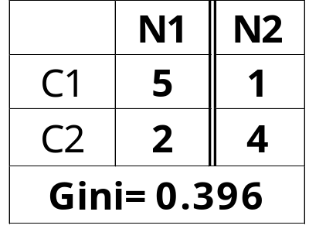
Binary Attributes: Computing GINI Index
Splits into two partitions
Effect of Weighing partitions:
  Larger and Purer Partitions are sought for.
B?
Yes
No
Gini(N1)
= 1 – (5/7)² – (2/7)²
= 0.408
Gini(N2)
= 1 – (1/5)² – (4/5)²
= 0.32
Node N1
Node N2
Gini(Children)
= 7/12 * 0.408 +
5/12 * 0.32
= 0.396

Slide 5



Categorical Attributes: Computing Gini Index
For each distinct value, gather counts for each class in the dataset
Use the count matrix to make decisions
Multi-way split
Two-way split
(find best partition of values)

Slide 6

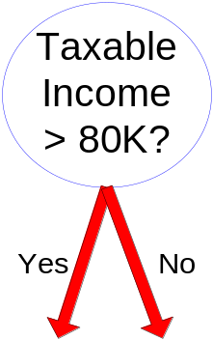
Continuous Attributes: Computing Gini Index
Use Binary Decisions based on one value
Several Choices for the splitting value
  Number of possible splitting values
  = Number of distinct values
Each splitting value has a count matrix associated with it
  Class counts in each of the partitions, A < v and A ≥ v
Simple method to choose best v
  For each v, scan the database to gather count matrix and compute its Gini index
  Computationally Inefficient! Repetition of work.

Slide 7
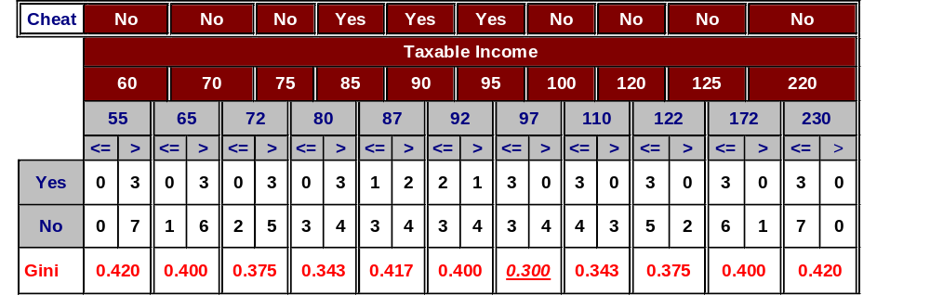
Continuous Attributes: Computing Gini Index...
For efficient computation: for each attribute,
  Sort the attribute on values
  Linearly scan these values, each time updating the count matrix and computing gini index
  Choose the split position that has the least gini index
Sorted Values
Split Positions

Slide 8
Ex 1: Decision Tree Induction to Predict the Risk Class of a bank loan Applicant using Gini Index
Owns Home? | Married? | Gender? | Employed? | Credit Rating? | Risk Class
Yes | Yes | Male | Yes | A | B
No | No | Female | Yes | A | A
Yes | Yes | Female | Yes | B | C
Yes | No | Male | No | B | B
No | Yes | Female | Yes | B | C
No | No | Female | Yes | B | A
No | No | Male | No | B | B
Yes | No | Female | Yes | A | A
No | Yes | Female | Yes | A | C
Yes | Yes | Female | Yes | A | C
CSE-307-Data Mining

Slide 9
Ex 1: Decision Tree Induction to Predict the Risk Class of a bank loan Applicant using Gini Index …contn..
Steps to be done on board
Refer 5.3 – Example using Gini Index
CSE-307-Data Mining

Slide 10

Alternative Splitting Criteria based on INFO
Entropy at a given node t:
    (NOTE: p( j | t) is the relative frequency of class j at node t).
  Measures homogeneity of a node.
    Maximum (log n_{c}) when records are equally distributed among all classes implying least information
    Minimum (0.0) when all records belong to one class, implying most information

Slide 11

Examples for computing Entropy
P(C1) = 0/6 = 0 P(C2) = 6/6 = 1
Entropy = – 0 log 0 – 1 log 1 = – 0 – 0 = 0
P(C1) = 1/6 P(C2) = 5/6
Entropy = – (1/6) log₂ (1/6) – (5/6) log₂ (5/6) = 0.65
P(C1) = 2/6 P(C2) = 4/6
Entropy = – (2/6) log₂ (2/6) – (4/6) log₂ (4/6) = 0.92

Slide 12

Splitting Based on INFO...
Information Gain:
    Parent Node, p is split into k partitions;
    n_{i} is number of records in partition i
  Measures Reduction in Entropy achieved because of the split. Choose the split that achieves most reduction (maximizes GAIN)
  Used in ID3 and C4.5
  Disadvantage: Tends to prefer splits that result in large number of partitions, each being small but pure.

Slide 13
ID3 – Iterative Dichotomizer
Invented by J. Ross Quinlan
Employs a top-down greedy search through the space of possible decision trees.
Greedy because there is no backtracking. It picks highest values first.
Select attribute that is most useful for classifying examples (attribute that has the highest Information Gain).

Slide 14

Entropy
Entropy measures the impurity of an arbitrary collection of examples.
For a collection S, entropy is given as:
For a collection S having positive and negative examples
Entropy(S) = -p₊log₂p₊ - p₋log₂p₋
where p₊ is the proportion of positive examples
and p₋ is the proportion of negative examples
In general, Entropy(S) = 0 if all members of S belong to the same class.
Entropy(S) = 1 (maximum) when all members are split equally.

Slide 15

Information Gain
Measures the expected reduction in entropy. The higher the IG, more is the expected reduction in entropy.
where Values(A) is the set of all possible values for attribute A,
S_{v} is the subset of S for which attribute A has value v.

Slide 16
Example : Determine whether an animal lays eggs using entropy
Independent/Condition attributes |  |  |  |  | Dependent/Decision attributes
Animal | Warm-blooded | Feathers | Fur | Swims | Lays Eggs
Ostrich | Yes | Yes | No | No | Yes
Crocodile | No | No | No | Yes | Yes
Raven | Yes | Yes | No | No | Yes
Albatross | Yes | Yes | No | No | Yes
Dolphin | Yes | No | No | Yes | No
Koala | Yes | No | Yes | No | No

Slide 17

Entropy(4Y,2N): -(4/6)log₂(4/6) – (2/6)log₂(2/6)
= 0.91829
Now, we have to find the IG for all four attributes Warm-blooded, Feathers, Fur, Swims

Slide 18
For attribute ‘Warm-blooded’:
Values(Warm-blooded) : [Yes,No]
S = [5Y,1N]
S_{Yes} = [3Y,2N] E(S_{Yes}) = 0.97095
S_{No} = [1Y,0N] E(S_{No}) = 0 (all members belong to same class)
Gain(S,Warm-blooded) = 0.91829 – [(5/6)*0.97095 + (1/6)*0]
= 0.10916
For attribute ‘Feathers’:
Values(Feathers) : [Yes,No]
S = [4Y,2N]
S_{Yes} = [3Y,0N] E(S_{Yes}) = 0
S_{No} = [1Y,2N] E(S_{No}) = 0.91829
Gain(S,Feathers) = 0.91829 – [(3/6)*0 + (3/6)*0.91829]
= 0.45914

Slide 19
For attribute ‘Fur’:
Values(Fur) : [Yes,No]
S = [5Y,1N]
S_{Yes} = [0Y,1N] E(S_{Yes}) = 0
S_{No} = [4Y,1N] E(S_{No}) = 0.7219
Gain(S,Fur) = 0.91829 – [(1/6)*0 + (5/6)*0.7219]
= 0.3167
For attribute ‘Swims’:
Values(Swims) : [Yes,No]
S = [4Y,2N]
S_{Yes} = [1Y,1N] E(S_{Yes}) = 1 (equal members in both classes)
S_{No} = [3Y,1N] E(S_{No}) = 0.81127
Gain(S,Swims) = 0.91829 – [(2/6)*1 + (4/6)*0.81127]
= 0.04411

Slide 20
Gain(S,Warm-blooded) = 0.10916
Gain(S,Feathers) = 0.45914
Gain(S,Fur) = 0.31670
Gain(S,Swims) = 0.04411
Gain(S,Feathers) is maximum, so it is considered as the root node
Animal | Warm-blooded | Feathers | Fur | Swims | Lays Eggs
Ostrich | Yes | Yes | No | No | Yes
Crocodile | No | No | No | Yes | Yes
Raven | Yes | Yes | No | No | Yes
Albatross | Yes | Yes | No | No | Yes
Dolphin | Yes | No | No | Yes | No
Koala | Yes | No | Yes | No | No
The ‘Y’ descendant has only positive examples and becomes the leaf node with classification ‘Lays Eggs’
Feathers
Y
N
[Ostrich, Raven,
Albatross]
[Crocodile, Dolphin,
Koala]
Lays Eggs
?

Slide 21

Animal | Warm-blooded | Feathers | Fur | Swims | Lays Eggs
Crocodile | No | No | No | Yes | Yes
Dolphin | Yes | No | No | Yes | No
Koala | Yes | No | Yes | No | No
We now repeat the procedure,
S: [Crocodile, Dolphin, Koala]
S: [1+,2-]
Entropy(S) = -(1/3)log₂(1/3) – (2/3)log₂(2/3)
= 0.91829

Slide 22
For attribute ‘Warm-blooded’:
Values(Warm-blooded) : [Yes,No]
S = [1Y,2N]
S_{Yes} = [0Y,2N] E(S_{Yes}) = 0
S_{No} = [1Y,0N] E(S_{No}) = 0
Gain(S,Warm-blooded) = 0.91829 – [(2/3)*0 + (1/3)*0] = 0.91829
For attribute ‘Fur’:
Values(Fur) : [Yes,No]
S = [1Y,2N]
S_{Yes} = [0Y,1N] E(S_{Yes}) = 0
S_{No} = [1Y,1N] E(S_{No}) = 1
Gain(S,Fur) = 0.91829 – [(1/3)*0 + (2/3)*1] = 0.25162

Slide 23
For attribute ‘Swims’:
Values(Swims) : [Yes,No]
S = [1Y,2N]
S_{Yes} = [1Y,1N] E(S_{Yes}) = 1
S_{No} = [0Y,1N] E(S_{No}) = 0
Gain(S,Swims) = 0.91829 – [(2/3)*1 + (1/3)*0] = 0.25162
Gain(S,Warm-blooded) is maximum
CSE-307-Data Mining

Slide 24
The final decision tree will be:
Feathers
Y
N
Lays eggs
Warm-blooded
Y
N
Does not lay eggs
Lays Eggs

Slide 25
Splitting Based on INFO...
  Strategies to overcome the disadvantage of Information Gain
  Restrict the test conditions to binary splits only.
    Used in CART
  Modify the splitting criteria to take into account the no. of partitions produced by the attribute test condition.
    Used in C4.5
    Gain ratio determines the goodness of a split.

Slide 26


Splitting Based on INFO...
Gain Ratio:
    Parent Node, p is split into k partitions
    n_{i} is the number of records in partition i
  Adjusts Information Gain by the entropy of the partitioning (SplitINFO). Higher entropy partitioning (large number of small partitions) is penalized!
  An attribute with more no. of splits, has high SplitINFO, hence less GainRATIO.

Slide 27

Splitting Criteria based on Classification Error
Classification error at a node t :
Measures misclassification error made by a node.
    Maximum (1 - 1/n_{c}) when records are equally distributed among all classes, implying least interesting information
    Minimum (0.0) when all records belong to one class, implying most interesting information

Slide 28
Examples for Computing Error
P(C1) = 0/6 = 0 P(C2) = 6/6 = 1
Error = 1 – max (0, 1) = 1 – 1 = 0
P(C1) = 1/6 P(C2) = 5/6
Error = 1 – max (1/6, 5/6) = 1 – 5/6 = 1/6
P(C1) = 2/6 P(C2) = 4/6
Error = 1 – max (2/6, 4/6) = 1 – 4/6 = 1/3

Slide 29

Comparison among Splitting Criteria
Impurity measures for a 2-class problem:

Slide 30
Tree Induction
Greedy strategy.
  Split the records based on an attribute test that optimizes certain criterion.
Issues
  Determine how to split the records
    How to specify the attribute test condition?
    How to determine the best split?
  Determine when to stop splitting

Slide 31
Stopping Criteria for Tree Induction
Stop expanding a node when all the records belong to the same class
Stop expanding a node when all the records have similar attribute values
When the no. of records fall below a certain threshold
  Top-down recursive partitioning approach
  No. of records reduces down the tree.
  Leaf nodes – difficult to make a statistically significant decision – data fragmentation
  To avoid – stop growing the tree when the no. of records fall below a certain threshold.

Slide 32
Decision Tree Based Classification
Characteristics of DT induction
  Inexpensive to construct
  Extremely fast at classifying unknown records
  Easy to interpret for small-sized trees
  Accuracy is comparable to other classification techniques for many simple data sets
  Classifying a new test record is O(w) – w is the maximum depth of the tree.
Tree – pruning – reduce the size of the tree
Large DT are susceptible to overfitting
Pruning avoids overfitting and improves generalization capability.

Slide 33
Example: C4.5
Simple depth-first construction.
Uses Information Gain
Sorts Continuous Attributes at each node.
Needs entire data to fit in memory.
Unsuitable for Large Datasets.
You can download the software from:
http://www.cse.unsw.edu.au/~quinlan/c4.5r8.tar.gz

Slide 34
Model Evaluation
Metrics for Performance Evaluation
  How to evaluate the performance of a model?
Methods for Performance Evaluation
  How to obtain reliable estimates?
Methods for Model Comparison
  How to compare the relative performance among competing models?

Slide 35
Model Evaluation
Metrics for Performance Evaluation
  How to evaluate the performance of a model?
Methods for Performance Evaluation
  How to obtain reliable estimates?
Methods for Model Comparison
  How to compare the relative performance among competing models?

Slide 36
Metrics for Performance Evaluation
Focus on the predictive capability of a model
  Rather than how fast it takes to classify or build models, scalability, etc.
Confusion Matrix:
 | PREDICTED CLASS
ACTUAL CLASS |  | Class=Yes | Class=No
 | Class=Yes | a | b
 | Class=No | c | d
a: TP (true positive)
b: FN (false negative)
c: FP (false positive)
d: TN (true negative)

Slide 37
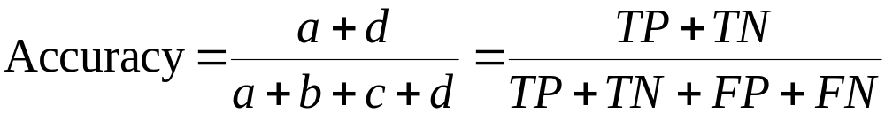
Metrics for Performance Evaluation…
 | PREDICTED CLASS
ACTUAL CLASS |  | Class=Yes | Class=No
 | Class=Yes | a (TP) | b (FN)
 | Class=No | c (FP) | d (TN)
Most widely-used metric:

Slide 38
Limitation of Accuracy
Consider a 2-class problem
  Number of Class 0 examples = 9990
  Number of Class 1 examples = 10
If model predicts everything to be class 0, accuracy is 9990/10000 = 99.9 %
  Accuracy is misleading because model does not detect any class 1 example

Slide 39
Cost in Business Intelligence
Most business/medical applications use cost + accuracy to evaluate model quality.
If a model classifies a customer with poor credit as low-risk category, this error is costly.
Cost matrix shows the cost of misclassifications and benefits of correct classifications.
Cost matrix helps to choose a model with minimum costly misclassifications.

Slide 40
Cost Matrix
 | PREDICTED CLASS
ACTUAL CLASS | C(i|j) | Class=Yes | Class=No
 | Class=Yes | C(Yes|Yes) | C(No|Yes)
 | Class=No | C(Yes|No) | C(No|No)
C(i|j): Cost of misclassifying class j example as class i

Slide 41
Computing Cost of Classification
Cost Matrix | PREDICTED CLASS
ACTUAL CLASS | C(i|j) | + | -
 | + | -1 | 100
 | - | 1 | 0
Model M₁ | PREDICTED CLASS
ACTUAL CLASS |  | + | -
 | + | 150 | 40
 | - | 60 | 250
Model M₂ | PREDICTED CLASS
ACTUAL CLASS |  | + | -
 | + | 250 | 45
 | - | 5 | 200
If M1 and M2 are classification models to diagnose cancer patients.
Accuracy = 80%
Cost = 3910
Accuracy = 90%
Cost = 4255

Slide 42
Some Performance measures for a Classifier
Assume the data set has
P positive instances and
N negative instances
True Positive Rate :-
The proportion of positive instances that
are correctly classified as positive.
TP/P
Also called hit rate/recall/sensitivity/TP
rate

Slide 43
Some Performance measures for a Classifier ……
2) False Positive Rate :-
The proportion of negative instances
that are erroneously classified as
positive.
FP/N
Also called False Alarm Rate/FP rate

Slide 44
Some Performance measures for a Classifier…..
3) False Negative Rate :-
The proportion of positive instances that
are erroneously classified as negative.
1 – True Positive Rate
FN/P
Also called FN rate

Slide 45
Some Performance measures for a Classifier…..
4) True Negative Rate :-
The proportion of negative instances
that are correctly classified as negative.
TN/N
Also called Specificity/TN rate

Slide 46
Some Performance measures for a Classifier…..
5) Precision:-
The proportion of instances that are
classified as positive that are really
positive.
TP/ (TP + FP)
Also called Positive Predictive Value .

Slide 47
Some Performance measures for a Classifier…..
6) F1 Score:-
A measure that combines Precision and
Recall.
( 2 x Precision x Recall) / (Precision +
Recall)

Slide 48
Some Performance measures for a Classifier….
7) Accuracy/Predictive Accuracy:-
The proportion of instances that are
correctly classified.
(TP + TN) / (P + N)

Slide 49
Some Performance measures for a Classifier….
8) Error Rate :-
The proportion of instances that are
incorrectly classified.
(FP + FN) / (P + N)

Slide 50
ROC (Receiver Operating Characteristic)
Developed in 1950s for signal detection theory to analyze noisy signals
  Characterize the trade-off between positive hits and false alarms
ROC curve plots TPR (on the y-axis) against FPR (on the x-axis)
Performance of each classifier represented as a point on the ROC curve
  changing the threshold of algorithm, sample distribution or cost matrix changes the location of the point

Slide 51
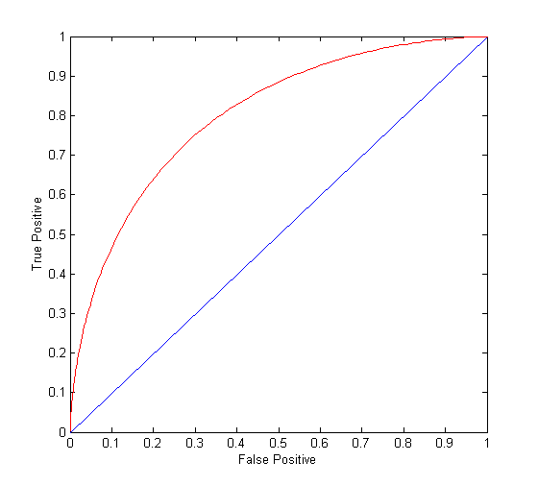
ROC Curve
(TPR,FPR):
(0,0): declare everything
to be negative class
(1,1): declare everything
to be positive class
(1,0): ideal
Diagonal line:
  Random guessing
  Below diagonal line:
    prediction is opposite of the true class

Slide 52
Model Evaluation
Metrics for Performance Evaluation
  How to evaluate the performance of a model?
Methods for Performance Evaluation
  How to obtain reliable estimates?
Methods for Model Comparison
  How to compare the relative performance among competing models?

Slide 53
Methods for Performance Evaluation
How to obtain a reliable estimate of performance?
Performance of a model may depend on other factors besides the learning algorithm:
  Class distribution
  Cost of misclassification
  Size of training and test sets

Slide 54
Methods of Estimation
Holdout method
  Reserve 2/3 for training and 1/3 for testing
  Disadv :
  1) if training set size is small, large variance of the model.
  It depends on the training set size.
  2) If training set size is large, then the accuracy got with
  smaller test size is less reliable.
  Random Subsampling:-
  Repeated holdout for k times.
  Disadv:
  No control over the no. of times each record is used for
  testing and training

Slide 55
Methods of Estimation
Cross Validation (CV):
Partition data into k disjoint subsets.
K-fold : train on k-1 partitions, test on the
remaining one partition
Leave-one-out CV :
K = n , where k = no. of folds, n = no. of
examples in the data set.
In all the above methods, training records are
sampled without replacement, i.e., no
duplicates in training and test set.

Slide 56
Methods of Estimation
Stratified Sampling:-
Identify the categorical variables to divide the
data set into stratum/subgroups. (Gender,
Marital status, etc)
Form stratum/subgroups.
Within each strata, all records have same
probability of being included in the sample.
Probability for each record to be sampled
differs across the strata.

Slide 57
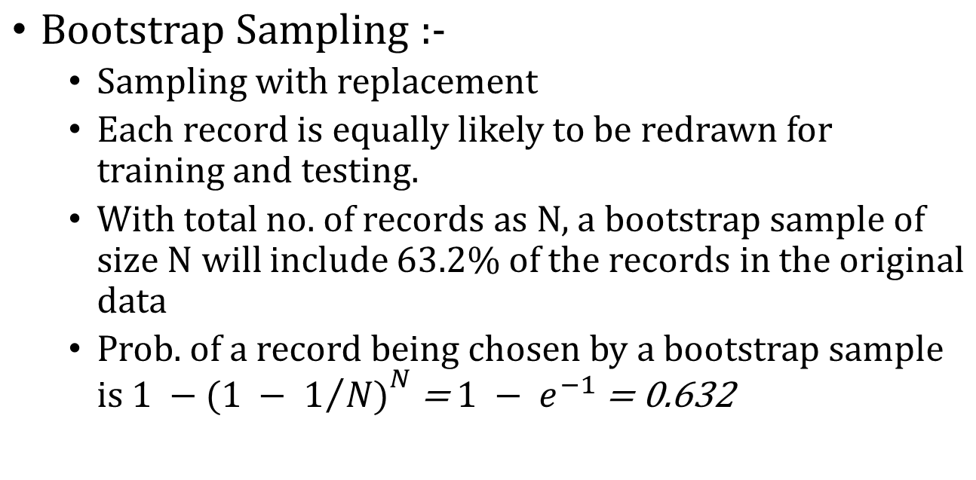
Methods of Estimation

Slide 58
Methods of Estimation

